Slide 1
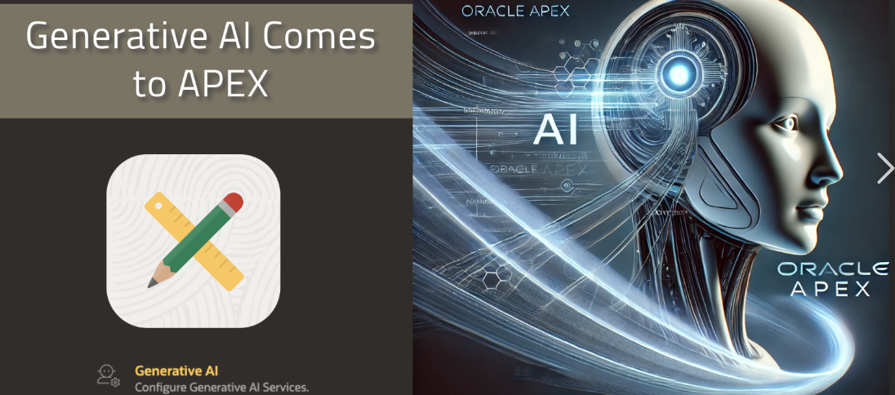
Integrating AI in Oracle APEX A Developer’s Workshop on OpenAI, OCI GenAI, and Cohere
Empowering APEX Developers: Integrating AI Capabilities
Configuring and Utilizing OpenAI, OCI Generative AI, and Cohere
Hansel Delos Santos
Certified Oracle Apex Professional
Lecturer – Software Engineering Unit
April 28, 2026 | 12:00 – 2:00 PM | BSIT-17L

Slide 2
Workshop Agenda
Goal: To enable developers to seamlessly configure and consume AI services within Oracle APEX applications.
Introduction: The Low-Code + AI Paradigm.
Prerequisites: Setup and Credentials.
Deep Dive: OCI Generative AI: The Native Oracle Experience.
Deep Dive: OpenAI: Leveraging GPT Generative Pre-Trained Transformer Models.
Deep Dive: Cohere: Enterprise-Focused NLP.
APEX Implementation: Shared Components & Dynamic Actions.
Hands-On Lab: Building an AI-Powered Assistant.
Best Practices: Security, Cost, and Performance.

Slide 3
Pre-requisites
Before We Start Developing:
Oracle Cloud Account: Required for OCI(Oracle Cloud Infrastructure) Generative AI service.
API Keys:
OpenAI API Key (from platform.openai.com).
Cohere API Key (from dashboard.cohere.com).
APEX Environment: Version 23.2 or later (24.1 recommended for native AI features).

Slide 4
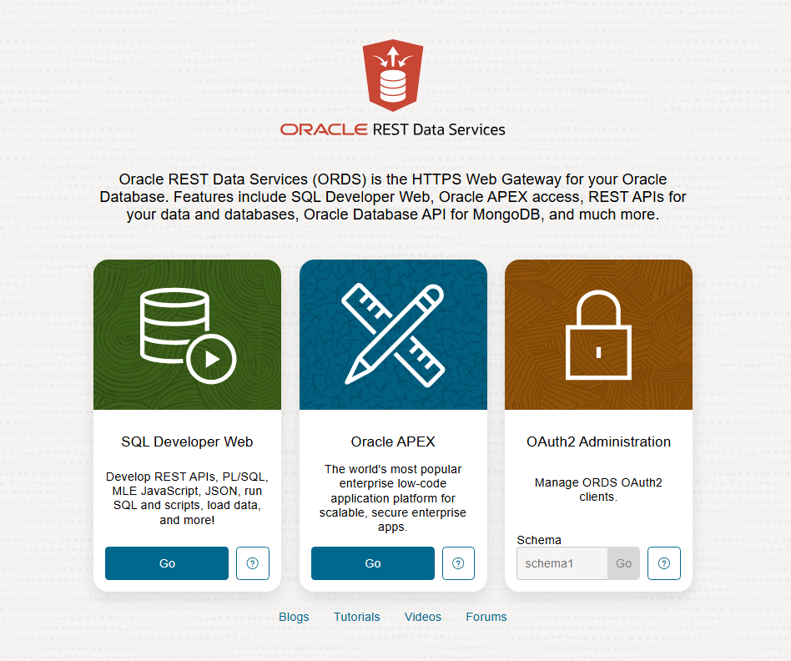
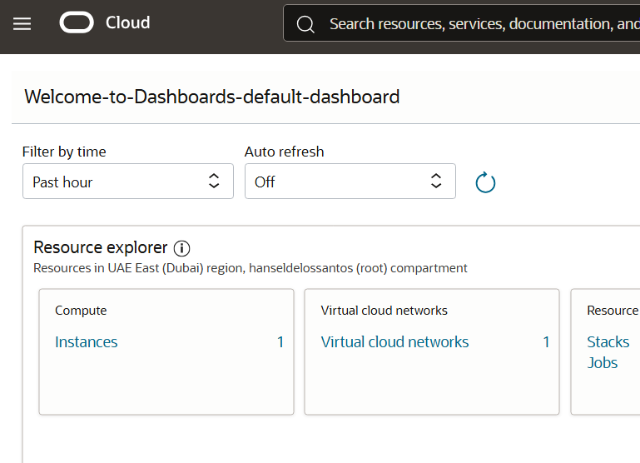
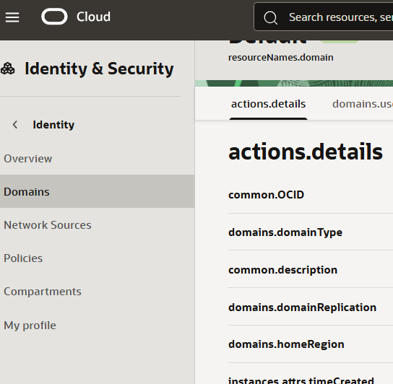
OCI / APEX
Before We Start Developing:
https://cloud.oracle.com/
https://apex.oracle.com/apex/

Slide 5
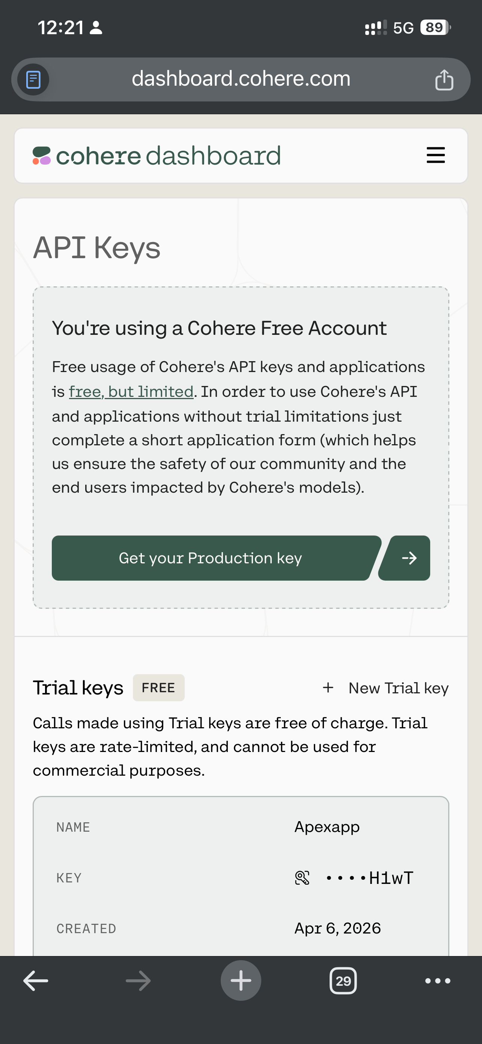
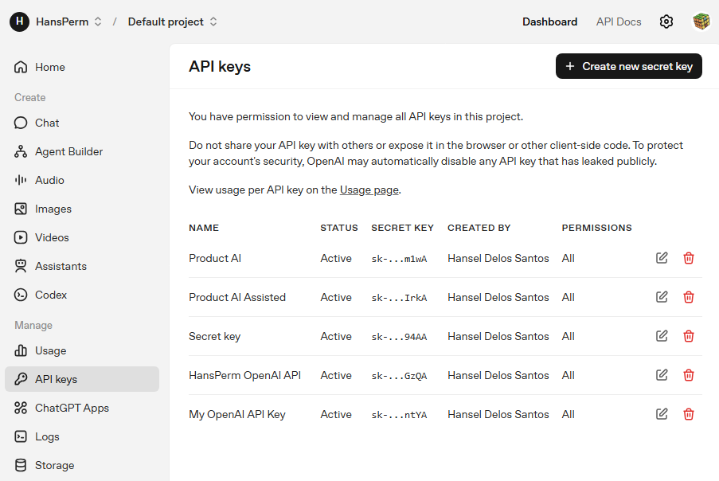
API Keys
Before We Start Developing:
platform.openai.com
dashboard.cohere.com

Slide 6
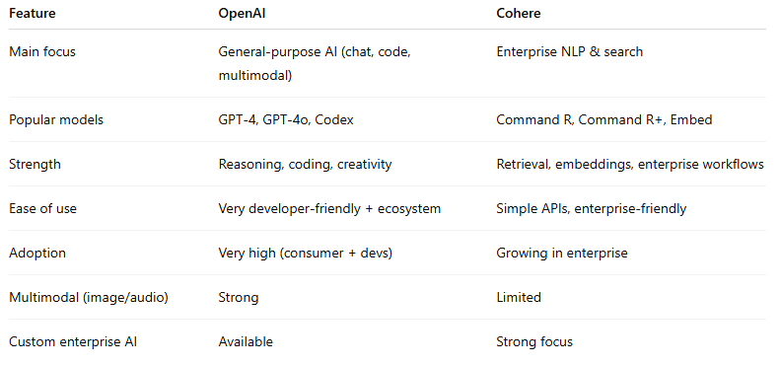
Quick Comparison:OpenAI vs Cohere

Slide 7
Architecture Overview
APEX App -> Calls Generative AI Service (Shared Component).
Service -> Uses Web Credential (Secret Key).
Request -> Sent via HTTPS to Provider API.
Response -> Rendered in APEX Region/Item.
or
User → Oracle APEX App → REST API → AI Service (OpenAI / OCI / Cohere) → Response to Application
or
Hard-coded skipping APEX credentials completely and use a direct header workaround that works in almost all APEX versions

Slide 8
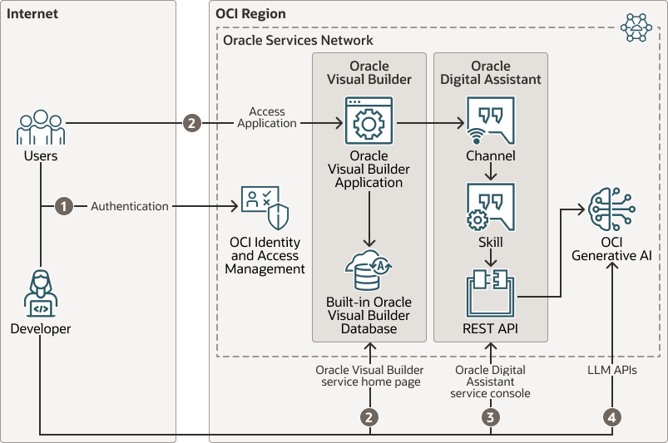
Empowering APEX Developers: Integrating AI Capabilities
Enabling Developers to Configure and Utilize AI Capabilities in Oracle APEX
Using OpenAI, OCI Generative AI, and Cohere

Slide 9
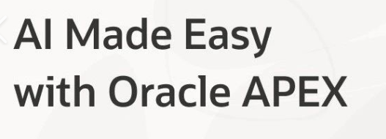
Workshop Objectives
Understand AI integration in Oracle APEX
Explore OpenAI, OCI Generative AI, and Cohere
Learn how to configure AI services
Build AI-powered application features

Slide 10
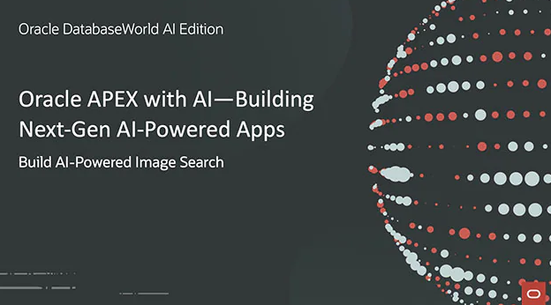
Introduction to AI in Oracle APEX
Oracle APEX allows developers to integrate AI services into web applications.
AI can enhance automation, decision making, and user interaction.

Slide 11
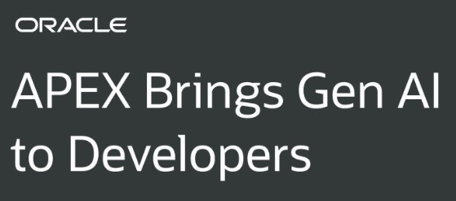
Why Integrate AI?
Improve user experience
Automate repetitive tasks
Generate insights from data
Enable intelligent chat and recommendations

Slide 12

OpenAI Integration
Use OpenAI APIs within APEX
Generate text, summaries, and chatbot responses
Connect via REST APIs (Representational State Transfer & Application Programming Interface)

Slide 13
Provider 1 - OpenAI
The Industry Standard
Overview: Access to GPT-3.5, GPT-4, and GPT-4o models.
Strengths: Best general-purpose reasoning, coding assistance, and creative writing.
Considerations:
Data leaves the Oracle network.
Pay-per-token pricing model.
Configuration in APEX:
Base URL: https://api.openai.com/v1/chat/completions
Authentication: Bearer Token (API Key).

Slide 14

OCI Generative AI Services
Oracle Cloud Infrastructure provides native AI services
Secure integration with Oracle ecosystem
Supports enterprise-scale applications

Slide 15
Provider 2 - OCI Generative AI
The Native Choice
Overview: Fully managed, serverless service within Oracle Cloud Infrastructure.
Key Models:
Llama (Large Language Mode Meta AI) 3 (Meta).
Cohere Command models (Hosted on OCI).
Advantages:
Data Privacy: Data stays within the OCI tenancy.
No Egress Costs: Low latency if your ADB is in the same region.
Dedicated AI Clusters: For high-volume, predictable performance.
Configuration Steps:
Enable "Generative AI" service in OCI Console.
Create a dedicated AI compartment and policy.

Slide 16

Cohere AI Capabilities
Natural language processing
Text generation
Classification and semantic search

Slide 17
Practical Use Cases
AI chatbot support
Automatic content generation
Smart form assistance
Data summarization

Slide 18
Hands-On Demo - Code Snippet
PL/SQL Block Example (OpenAI)
declare
l_request clob;
l_response clob;
begin
-- Construct the JSON Payload
apex_json.initialize_clob_output;
apex_json.open_object;
apex_json.write('model', 'gpt-4o');
apex_json.open_array('messages');
apex_json.open_object;
apex_json.write('role', 'user');
apex_json.write('content', :P1_PROMPT); -- Page Item
apex_json.close_object;
apex_json.close_array;
apex_json.close_object;
l_request := apex_json.get_clob_output;
-- Call the API
l_response := apex_web_service.make_request(
p_url => 'https://api.openai.com/v1/chat/completions',
p_http_method => 'POST',
p_credential_static_id => 'OPENAI_CRED',
p_body => l_request );
-- Parse response and set page item
:P1_RESPONSE := apex_json.get_varchar2(p_path => 'choices[1].message.content', p_response => l_response);
end;

Slide 19
Use Case – RAG (Retrieval-Augmented Generation) with APEX
Chat with your Data
Select Data: User selects a row in an Interactive Grid (e.g., Support Ticket).
Context Injection: PL/SQL process concatenates the ticket details into a System Prompt.
"You are a support agent. Summarize the following ticket: [Ticket Details]"
AI Generation: Send prompt to OCI GenAI or OpenAI.
Display: Update a rich text editor region with the AI summary.
This pattern transforms static data applications into intelligent assistants.
end;

Slide 20
APEX Configuration (Step-by-Step)
Setting up Shared Components
Step 1: Web Credentials
Navigate to Shared Components > Web Credentials.
Create "OpenAI_Cred" / "Cohere_Cred".
Authentication Type: Bearer Token.
Paste your API Key in the password field.
Step 2: Generative AI Service (APEX 24.1+)
Navigate to Shared Components > Generative AI Services.
Click Create.
Select Provider (OpenAI, OCI, Cohere).
Map the Web Credential created in Step 1.
Test the connection.

Slide 21
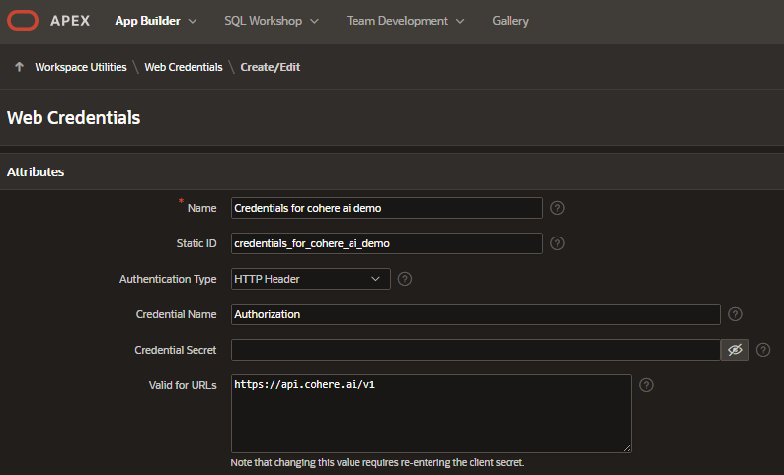
Web Credentials

Slide 22
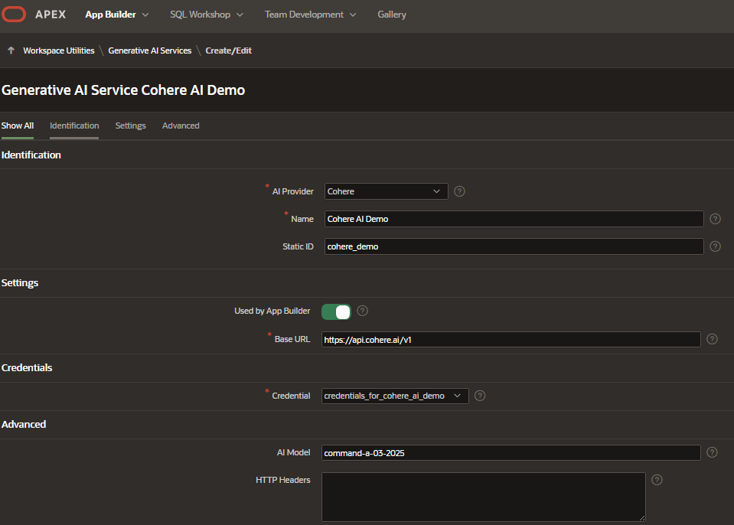
Generative AI Services

Slide 23
Provider 3 - Cohere
The Enterprise Specialist
Overview: Specialized in enterprise-grade NLP (Natural Language Processing).
Key Models:
Command: Instruction-following text generation.
Rerank: Improves search relevance (excellent for RAG).
Embed: Vector generation for semantic search.
Advantages:
Strong focus on RAG (Retrieval-Augmented Generation) workflows.
Available directly via Cohere API or via OCI GenAI managed service.

Slide 24
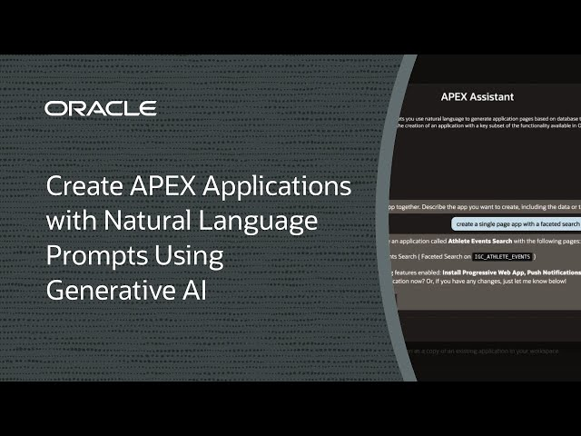
Implementation Methods
How to use AI in your App
Method A: AI Assistant Dynamic Action (No Code)
Use the native "Generate Text with AI" dynamic action.
Link an input field (Prompt) to a display region.
Ideal for simple chat interfaces or text generation.

Slide 25
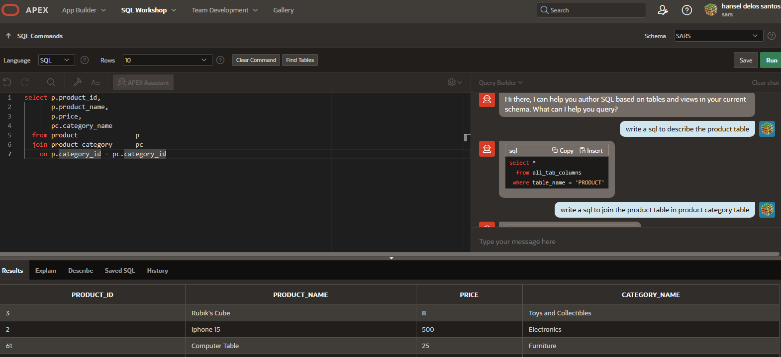
Implementation Methods
How to use AI in your App
Method B: PL/SQL API (Pro Code)
Use APEX_AI.GENERATE (Native in 24.1).
Use APEX_WEB_SERVICE.MAKE_REQUEST (Custom JSON-JavaScript Object Notation handling).
Offers full control over temperature, max tokens, and system prompts.

Slide 26
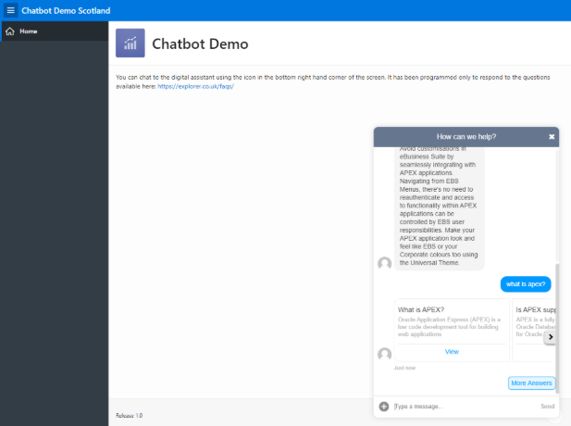
Implementation Methods
How to use AI in your App
Method C: Integrate Chatbots in you Applications

Slide 27
Best Practices
Protect API keys
Optimize prompts
Manage API costs
Validate AI outputs

Slide 28
Conclusion
AI integration in Oracle APEX enables powerful intelligent applications.
Developers can easily leverage OpenAI, OCI Generative AI, and Cohere to enhance functionality.

Slide 29
Demonstration
AI Intelligence to Oracle APEX Apps
Pre-requisite:
Oracle APEX AI Integration | ChatGPT

Slide 30
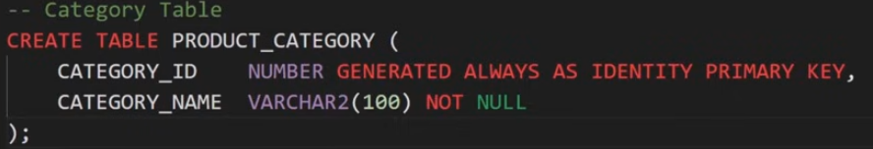
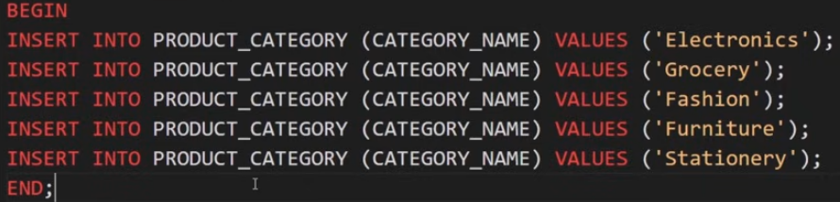
Create schema

Slide 31
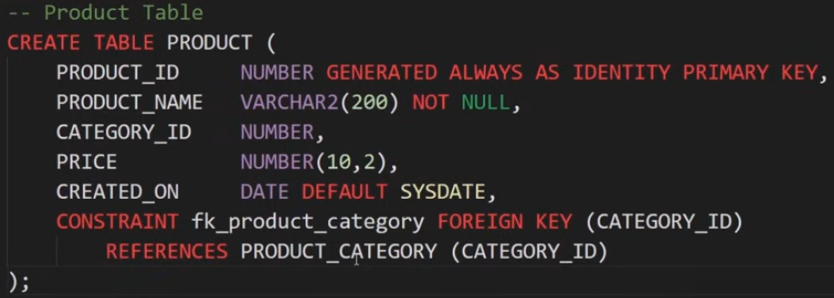

Slide 32
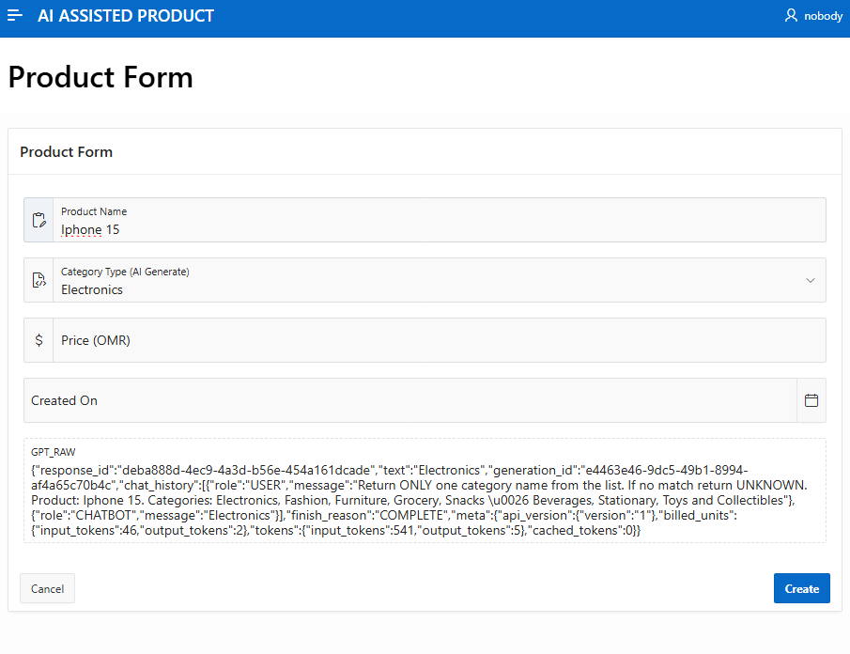
Create an Application

Slide 33
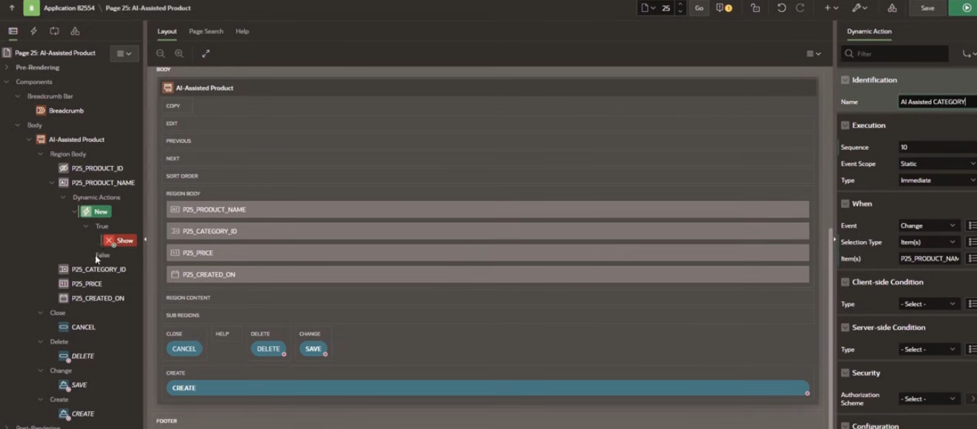
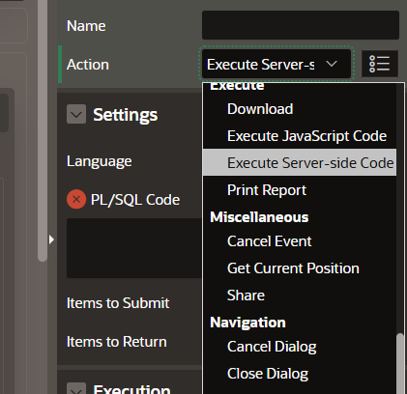
Create Dynamic Action

Slide 34
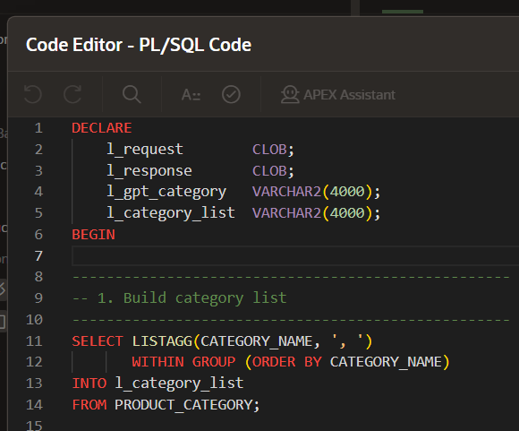
PL/SQL – step 1 (build list of category)

Slide 35
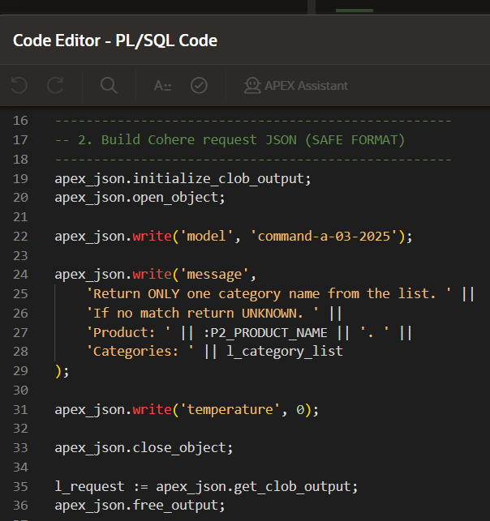
PL/SQL – step 2 (build GPT JSON request)

Slide 36
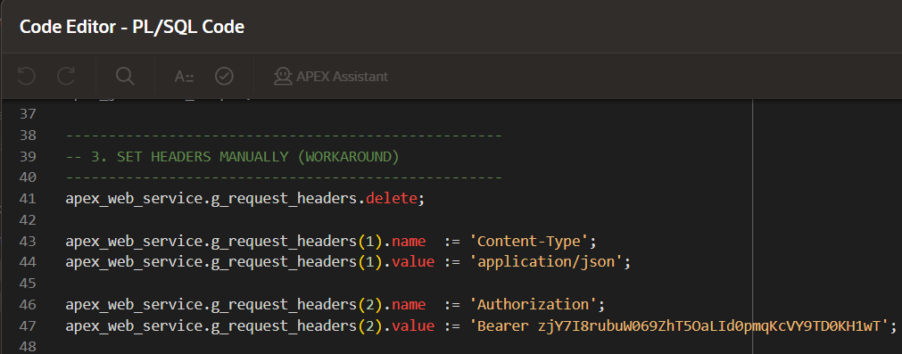
PL/SQL – step 3 (set headers)

Slide 37
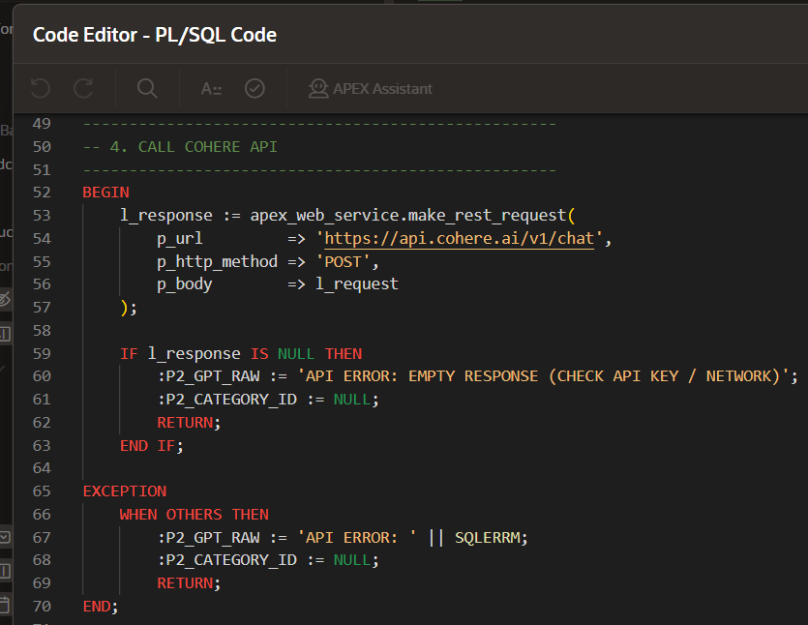
PL/SQL –step 4 (call AI API)

Slide 38
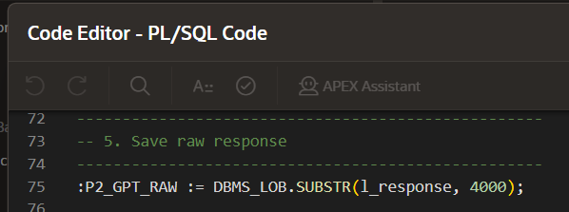
PL/SQL – step 5 (save response)

Slide 39
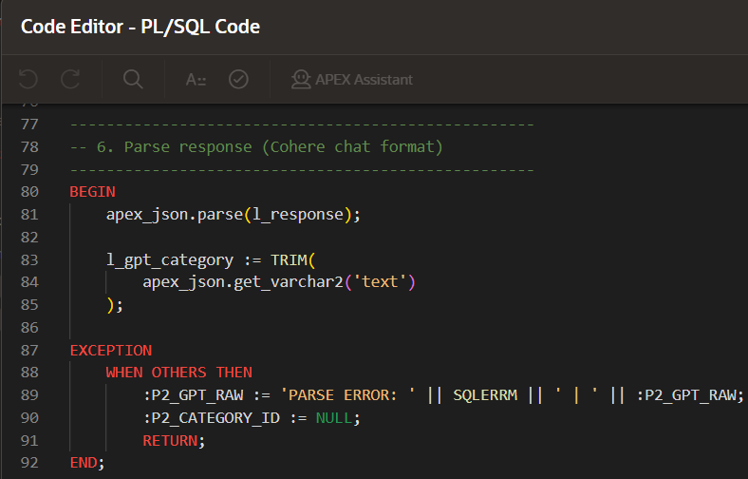
PL/SQL – step 6 (parse GPT response)

Slide 40
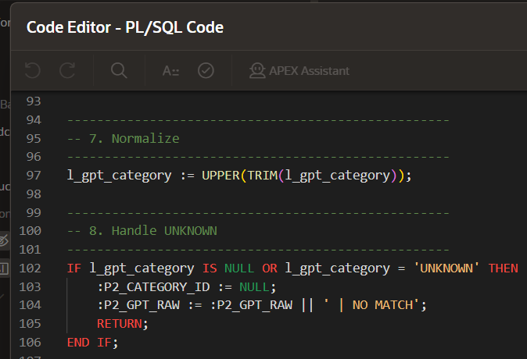
PL/SQL – step 7 (normalize & handling)

Slide 41
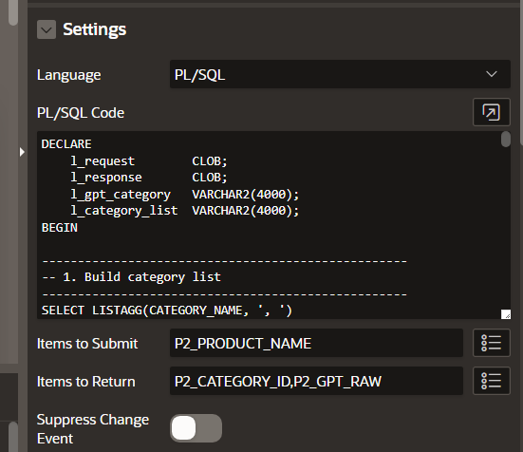
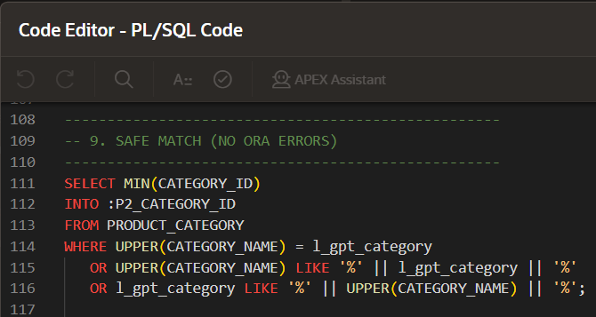
PL/SQL – step 8 (match the product category)

Slide 42
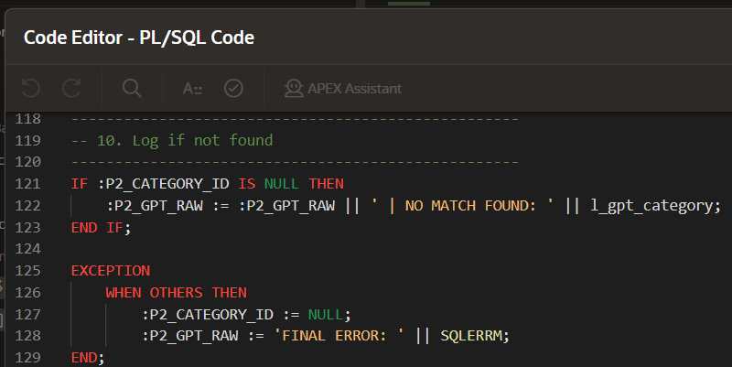
PL/SQL – step 9 (not match the product category)

Slide 43
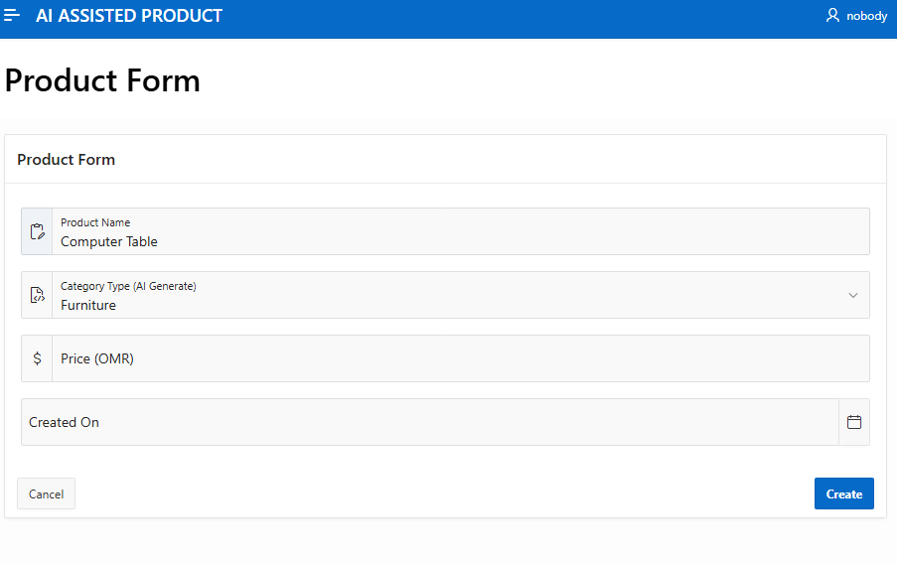
Finished Product

Slide 44

Oracle APEX
AI – Assisted Product Demo
Thank You…..
https://github.com/hansperm/Oracle-Apex---AI-Assisted-Product.git

